Slide 1
Exception Handling
and
Data Validation

Slide 2
Objectives
At the end of this lecture, you will be able to
Understand Exceptions
Handle Exceptions using try-catch-finally block
Perform data validation by exception handling

Slide 3
Reading Reference
Exceptions and Exception Handling (C# Programming Guide)
https://docs.microsoft.com/en-us/dotnet/csharp/programming-guide/exceptions/
How to use the try/catch block to catch exceptions https://docs.microsoft.com/en-us/dotnet/csharp/programming-guide/exceptions/
How to use specific exceptions in a catch block https://docs.microsoft.com/en-us/dotnet/standard/exceptions/how-to-use-specific-exceptions-in-a-catch-block
Exception Handling in C# https://www.tutorialsteacher.com/csharp/csharp-exception-handling

Slide 4
Exception Handling
As a rule, program should perform flawlessly
At times programs may also fail
It is the developer’s responsibility to produce programs that properly handle failure, making sure it run or else terminate gracefully

Slide 5
Why Do Programs Fail?
Program fail due to TWO reasons :
External Failure:
Failure resulting from an inability to acquire a resource
Program trying to open a file that does not exist
Attempt to open a non-sharable file that is being used by another program
Internal Failure:
Failure resulting from flawed code
Calculations that result in divide by zero failure
An attempt to access an object’s method through null reference (object not initialized)

Slide 6
Exception
An object created (or thrown) when an error condition occurs
It encapsulates the information about the error
If not handled, program may terminate abnormally
In many cases, exception handling allows program to continue execution as though no problem had been encountered
>> Helps to create robust and fault tolerant programs that either continue executing or terminate gracefully

Slide 7
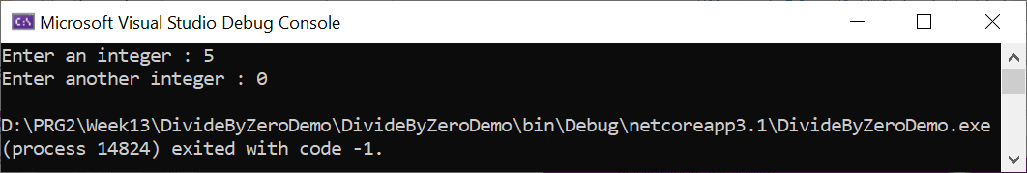
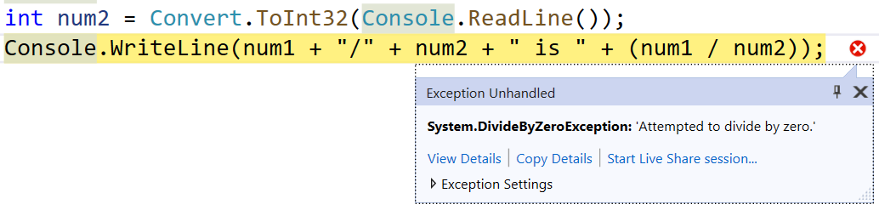
Exception not handled
Console.Write("Enter an integer : ");
int num1 = Convert.ToInt32(Console.ReadLine());
Console.Write("Enter another integer : ");
int num2 = Convert.ToInt32(Console.ReadLine());
Console.WriteLine(num1 + "/" + num2 + " is " + (num1 / num2));
Running
program
In
Visual Studio

Slide 8
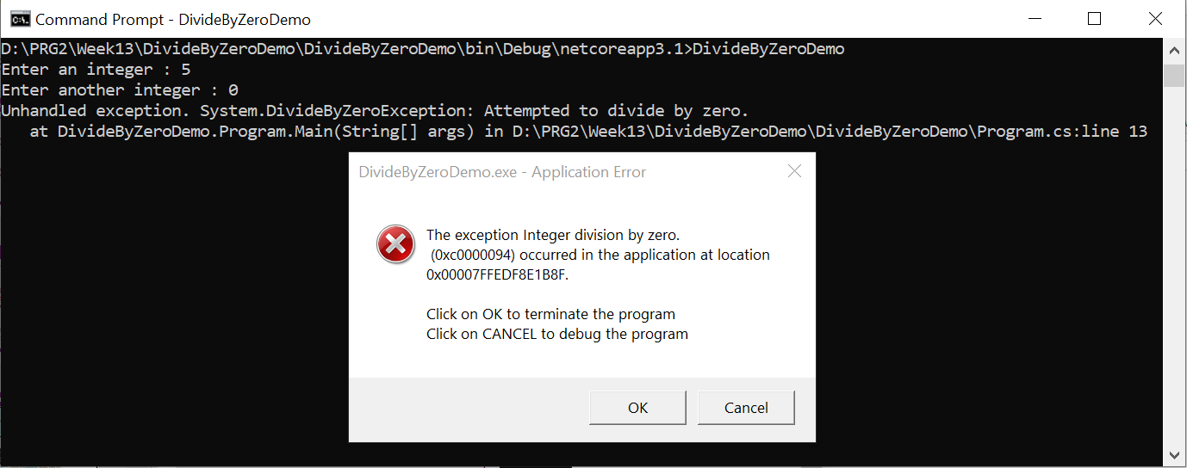
Exception not handled
Running .exe file in command prompt to simulate what user will see when exception occur

Slide 9
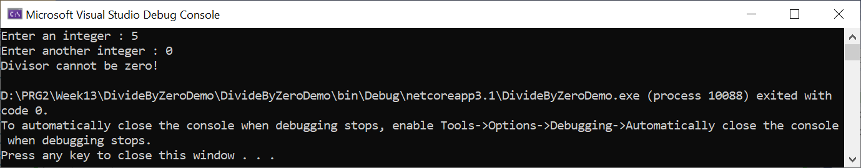
Fix error with Selection statement
Console.Write("Enter an integer : ");
int num1 = Convert.ToInt32(Console.ReadLine());
Console.Write("Enter another integer : ");
int num2 = Convert.ToInt32(Console.ReadLine());
if (num2 != 0)
Console.WriteLine(num1 + "/" + num2 + " is " + (num1 / num2));
else
Console.WriteLine("Divisor cannot be zero!");

Slide 10
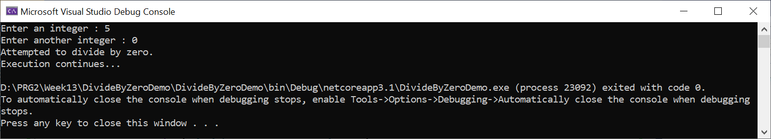
Fix error with Exception Handling
Console.Write("Enter an integer : ");
int num1 = Convert.ToInt32(Console.ReadLine());
Console.Write("Enter another integer : ");
int num2 = Convert.ToInt32(Console.ReadLine());
try
{
Console.WriteLine(num1 + "/" + num2 + " is " + (num1 / num2));
}
catch (DivideByZeroException ex)
{
Console.WriteLine(ex.Message);
}
Console.WriteLine("Execution continues...");

Slide 11
System.Exception Class
System.Exception is the base class for all exceptions
Properties contain information for the cause of the error or the unusual situation
Message
Provides details about the cause of an exception
StackTrace
Can be used to determine where an error occurred. The stack trace includes the source file name and program line number if debugging information is available

Slide 12
Using Exception Properties
try
{
Console.Write("Input a number: ");
int num = Convert.ToInt32(Console.ReadLine());
Console.WriteLine(num);
}
catch(FormatException ex)
{
Console.WriteLine("Exception details:");
Console.WriteLine(ex); //Exception type, message & stack trace
Console.WriteLine("Exception message: ");
Console.WriteLine(ex.Message); //Exception message
Console.WriteLine("Exception Stacktrace: ");
Console.WriteLine(ex.StackTrace); //Exception stack trace,
}

Slide 13
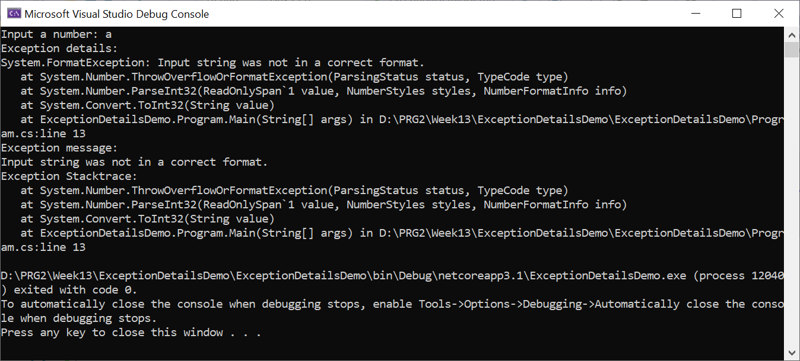
Using Exception Properties
Exception type
Exception Message
Exception stack trace

Slide 14
Some Common Exceptions
Exception Type | Description
ArithmeticException | A base class for exceptions that occur during arithmetic operations, such as System.DivideByZeroException and System.OverflowException.
ArrayTypeMismatchException | Thrown when a store into an array fails because the actual type of the stored element is incompatible with the actual type of the array.
DivideByZeroException | Thrown when an attempt to divide an integral value by zero occurs.
IndexOutOfRangeException | Thrown when an attempt to index an array via an index that is less than zero or outside the bounds of the array.
InvalidCastException | Thrown when an explicit conversion from a base type or interface to a derived type fails at run time.
NullReferenceException | Thrown when a null reference is used in a way that causes the referenced object to be required.

Slide 15
Some Common Exceptions
Exception Type | Description
OutOfMemoryException | Thrown when an attempt to allocate memory (via new) fails.
OverflowException | Thrown when an arithmetic operation in a checked context overflows.
StackOverflowException | Thrown when the execution stack is exhausted by having too many pending method calls; typically indicative of very deep or unbounded recursion.
TypeInitializationException | Thrown when a static constructor throws an exception, and no catch clauses exists to catch it.

Slide 16
Try-Catch-Finally
General Structure of
try-catch-finally
try
{
Normal operation code that might encounter
error condition
}
catch(ExceptionType ex)
{
Code to handle the exception / error handling
}
finally
{
Code to clean up (this block is optional)
}

Slide 17
Try-Catch-Finally
try block
Encloses the code that is executed in normal circumstances.
It comprises of code that might throw an exception and code that does not execute if an exception occurs.
catch block
Catches and handles an exception
Type of exception specified by catch- block parameter (or exception parameter).
finally block
Encloses the code that cleans up any resources / restores the state
This block is optional.
This block will be executed at all times.

Slide 18
Try-Catch-Finally
Console.Write("Enter an integer : ");
int num1 = Convert.ToInt32(Console.ReadLine());
Console.Write("Enter another integer : ");
int num2 = Convert.ToInt32(Console.ReadLine());
try
{
Console.WriteLine(num1 + "/" + num2 + " is " + (num1 / num2));
}
catch (Exception ex)
{
Console.WriteLine("Message : " + ex.Message);
}
finally
{
Console.WriteLine("Finally executed");
}
Console.WriteLine("Execution continue…");

Slide 19
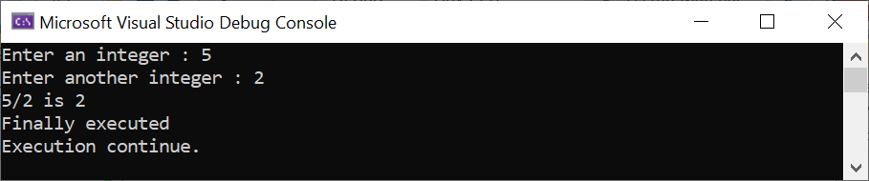
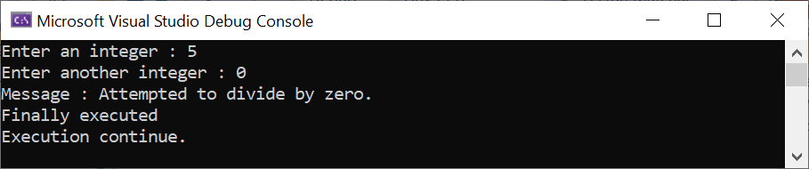
Try-Catch-Finally

Slide 20
Catching Multiple Exceptions
try
{
Console.Write("Enter an integer : ");
int num1 = Convert.ToInt32(Console.ReadLine());
Console.Write("Enter another integer : ");
int num2 = Convert.ToInt32(Console.ReadLine());
Console.WriteLine(num1 + "/" + num2 + " is " + (num1 / num2));
}
catch (DivideByZeroException ex)
{
Console.WriteLine(ex.Message);
}
catch (FormatException ex)
{
Console.WriteLine(ex.Message);
}

Slide 21
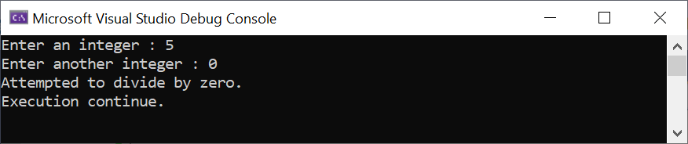
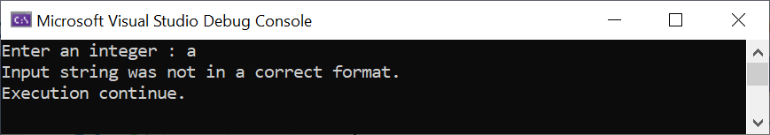
Catching Multiple Exceptions
catch (Exception ex)
{
Console.WriteLine(ex.Message);
}
Console.WriteLine("Execution continue…");

Slide 22
Catching Multiple Exceptions
The order of the catch is important.
The rule is to catch the more specific exception first.
Then followed by catching the more general exception.

Slide 23
Catching Multiple Exceptions
try
{
Console.Write("Enter an integer : ");
int num1 = Convert.ToInt32(Console.ReadLine());
Console.Write("Enter another integer : ");
int num2 = Convert.ToInt32(Console.ReadLine());
Console.WriteLine(num1 + "/" + num2 + " is " + (num1 / num2));
}
catch (Exception ex)
{
Console.WriteLine(ex.Message);
}
catch (DivideByZeroException ex)
{
Console.WriteLine(ex.Message);
}
catch (FormatException ex)
{
Console.WriteLine(ex.Message);
}
This should be last
Unreachable code
Unreachable code

Slide 24
Exceptions Flow
public static void Main() {
try
{
int result = Divide();
Console.WriteLine("The result is " + result);
}
catch(Exception ex)
{
Console.WriteLine(ex.Message);
}
}
static int Divide() {
Console.Write("Enter an integer : ");
int num1 = Convert.ToInt32(Console.ReadLine());
Console.Write("Enter another integer : ");
int num2 = Convert.ToInt32(Console.ReadLine());
return num1 / num2;
}
Exceptions happen here will flow up to the calling method

Slide 25
Data Validation
A process to ensure the delivery of clean and clear data to the programs, application and services using it.
Also know as input validation
Validation can be achieved with Selection structure
In some situations, exception handling makes the validation easier i.e. validating the input data format

Slide 26
Common mistake in Data Validation
static void Divide()
{
try
{
Console.Write("Enter an integer : ");
int num1 = Convert.ToInt32(Console.ReadLine());
Console.Write("Enter another integer : ");
int num2 = Convert.ToInt32(Console.ReadLine());
Console.WriteLine(num1 + "/" + num2 + " is " + (num1 / num2));
}
catch (FormatException ex)
{
Console.WriteLine(ex.Message);
Console.WriteLine("Please try again.");
Divide();
}
}
By calling the method itself will result in recursion. It will eventually lead to stack overflow exception. Should avoid doing this.

Slide 27
Recommended correct way
static void Divide()
{
while (true)
{
try
{
Console.Write("Enter an integer : ");
int num1 = Convert.ToInt32(Console.ReadLine());
Console.Write("Enter another integer : ");
int num2 = Convert.ToInt32(Console.ReadLine());
Console.WriteLine(num1 + "/" + num2 + " is " + (num1 / num2));
break;
}
catch (FormatException ex)
{
Console.WriteLine(ex.Message);
Console.WriteLine("Please try again.");
}
}
}
Using a loop is the recommended correct way.

Slide 28
Summary
Understand Exceptions
Handle Exceptions using try-catch-finally block
Perform data validation by exception handling

